Slide 1
Poverty in EU between 2010 - 2020.
Python,API wrapper, MySQL and Excel.
Damian Borsiak and Jaime Sastre Crespo.

Slide 2
0. Index.
Goal of the project.
Flowchart.
Composite Indicator methodology.
Challenges.
Highlights and possibilities of improvement.
Main results.
Demo
Q&A Time!

Slide 3
1. Goal of the project.
Identify countries with the highest and lowest poverty rate between 2010 and 2020 in the EU.
And compare the accuracy between our indicator and a external and existing one.

Slide 4
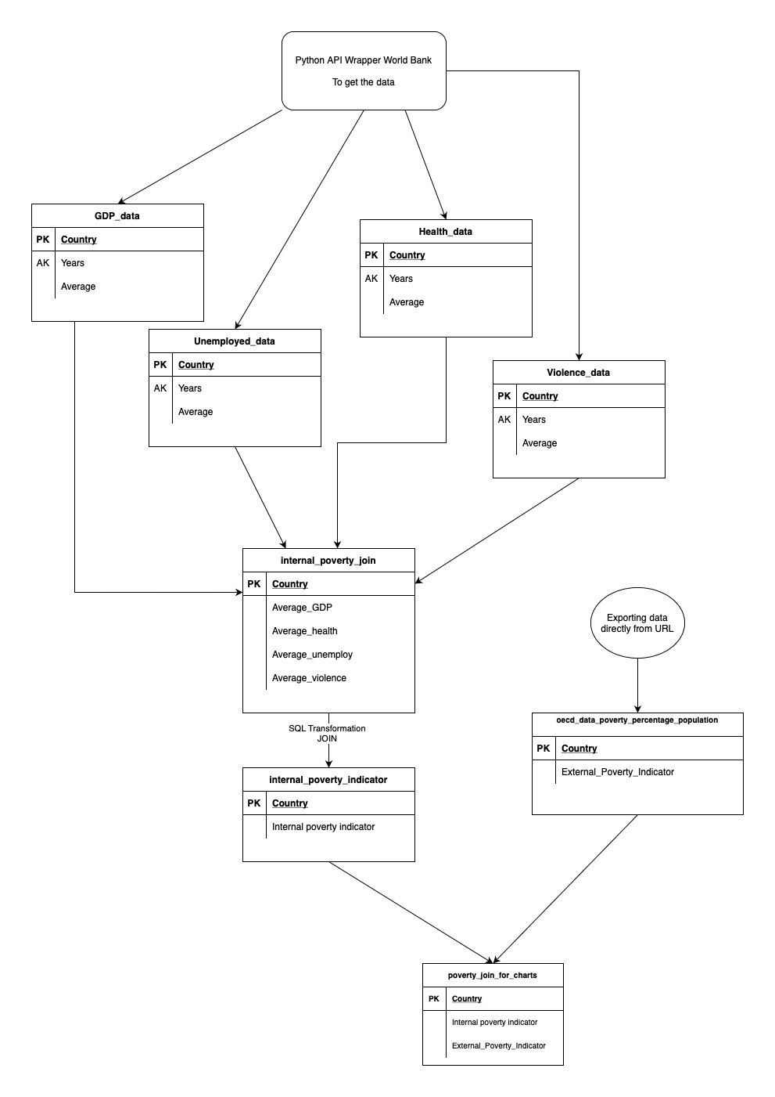
2. Flowchart.
Get the data through API Wrapper with Python.
https://data.worldbank.org/
4 tables as variables
GDP per capita per country($);
Expenditure on health care (%);
Unemployment rate (%);
Violence (per 100.000 people).
LEFT JOIN on MySQL to get our poverty indicator.
Exporting data of an external indicator.
https://data.oecd.org/inequality/poverty-rate.htm
LEFT JOIN on MySQL to have a table with both:
internal_poverty_indicator
external_poverty_indicator

Slide 5
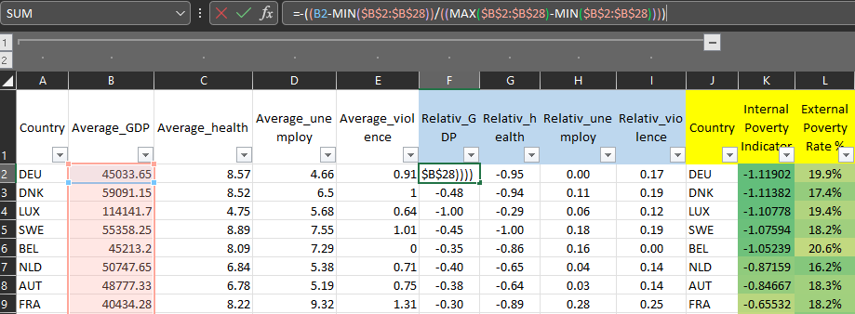
3. Composite Indicator methodology
(to normalize values).
poverty = - GDP - Health + Unemploy + Violence
x1 = (x-min(x))/(max(x)-min(x)) || To normalize values.

Slide 6
4. Challenges.
Incomplete data/ find reliable data.
Work with join left SQL for the first time.
Missing variables that we considered important (we wanted to introduce : corruption, school).

Slide 7
5. Highlights & possibilities of improvement.
As highlights:
We have noticed similars trends between our and external indicators
But we still have noticed few countries with significance differences.
As possibilities of improvement:
Find data more accurate and reliable.
Bigger number of variables.

Slide 8
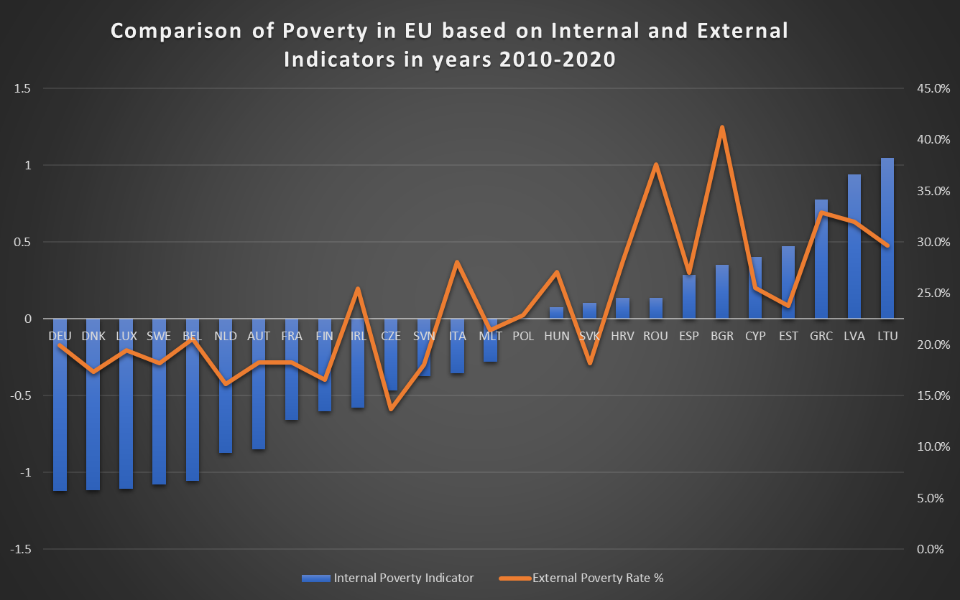


6. Main results .
MIN poverty
MAX poverty

Slide 9
7. Demo
https://github.com/JaimeSastreCrespo/Project_2_Python_SQL_Poverty/tree/main
https://github.com/Borysdb/Project_2_Python_SQL_Poverty.git

Slide 10
8. Q&A TIME, PLEASE ):

Slide 11

LEVEL OF POORNESS AFTER THE BOOTCAMP

